Slide 1

Lovely Professional University
Phagwara, Punjab
November 2024

Slide 2
CONTENT TABLE:
SL NO. | CONTENT | PAGE NO.
1 | PARTICULARS | 1
2 | INTRODUCTION | 4
3 | METHODOLOGY | 5
4 | TECHNOLOGIES | 6-8
5 | WEBSITE SNAPSHOTS | 9-14
6 | CONCLUSION | 15
7 | REFERENCES | 16

Slide 3
‘
INTRODUCTION
The "MyLearnNet" HTML project serves as an interactive educational platform, specifically tailored to explore and understand the complexities of banking and Investment. This project aims to provide users with an engaging learning experience through a well-designed webpage that seamlessly integrates informative content with modern web design principles. In response to the growing demand for accessible and visually appealing educational resources, "MyLearnNet" offers a user-friendly interface designed to enhance the understanding of banking and Investment concepts. The project's focus on HTML ensures broad accessibility, allowing users to access the content across various devices without compromising the quality of the learning experience. Through a combination of structured content and thoughtful design elements, "MyLearnNet" seeks to bridge the gap between education and technology, making banking concepts more approachable and comprehensible for a diverse audience. The project's simplicity in navigation and presentation aims to create an inclusive learning environment, catering to both beginners and those seeking to deepen their knowledge in the field of banking.

Slide 4
METHODOLOGY
The project was developed using HTML for the structure, CSS for styling. The development of this project followed a streamlined approach,
combining content structuring, responsive design, visual engagement, and user interaction to create an effective educational platform. This
website was designed to ensure that "MyLearnNet" achieves its primary objective of being an accessible, visually pleasing, and user-focused educational platform centered around banking concepts.

Slide 5
Building a website for Virtual Classroom and E-Learning Platform:
Technologies Used:
1. HTML:
- The backbone of the project, HTML was used to structure and organize the content. It facilitated the creation of essential elements like
headers, paragraphs, links, and multimedia embedding.
2. CSS:
- CSS was employed extensively for styling and layout purposes. It dictated the project's visual aesthetics, including color schemes, font styles,
responsive design, and animation effects like the dynamic rainbow background.

Slide 6
3. Media Integration:
- Images and embedded videos were seamlessly incorporated into the content using HTML and CSS. This enhances the overall learning
experience by providing visual elements to support the educational material.
4. Responsive Design:
- Media queries in CSS were utilized for responsive design, ensuring the project's adaptability across a variety of devices. This enhances
accessibility and usability for users accessing the platform from different screens.
5. Hyperlinks and Navigation:
- HTML hyperlinks were implemented to connect various pages of the project, including the home page, login page, and course contents. This
promotes easy navigation between different sections of the educational platform.

Slide 7
6. Testing Tools:
- Standard web browser developer tools were likely used for testing and debugging during the development phase. This ensures that the project
functions as intended across different browsers and devices.
By leveraging these technologies, including HTML for content structure, CSS for styling and layout, and potentially JavaScript for enhanced
interactivity, you've created a comprehensive educational platform encompassing the home page, login page, and course contents. This
combination provides a solid foundation for a user-friendly and visually engaging learning experience.

Slide 8
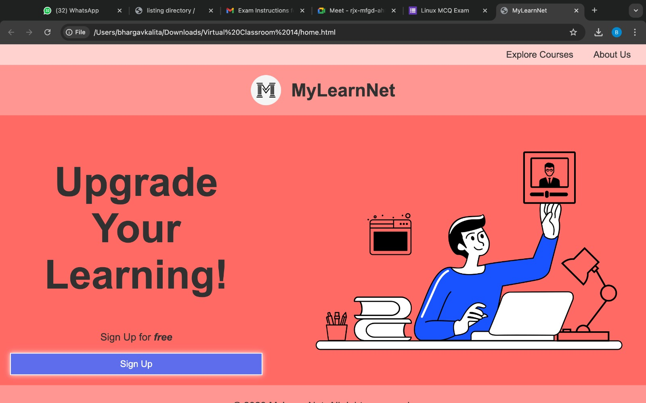
SCREENSHOTS:

Slide 9
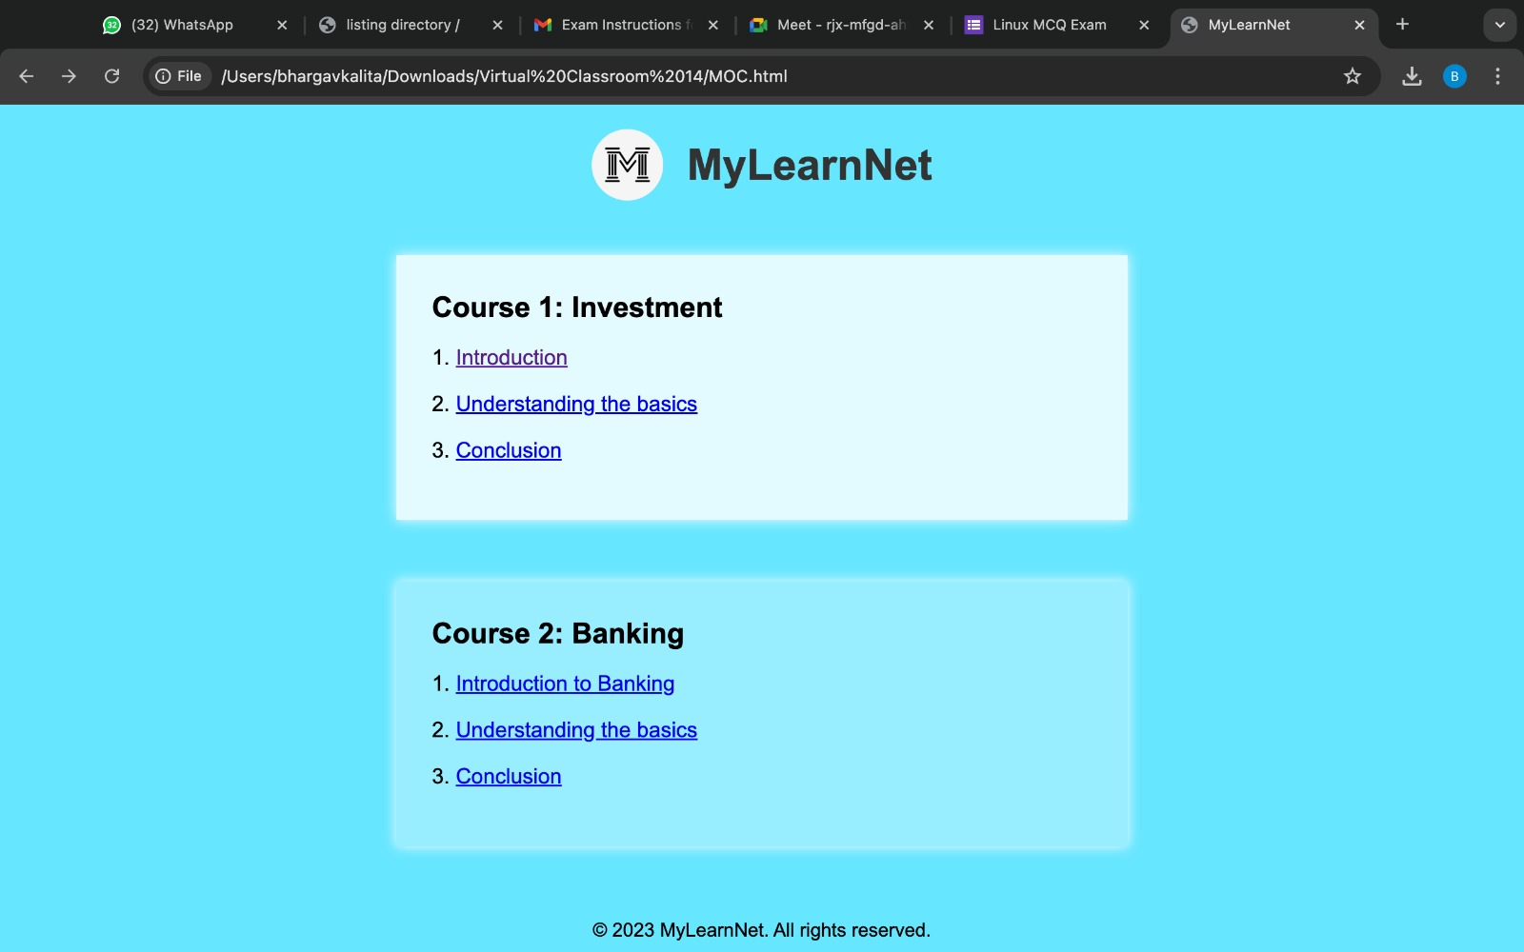

Slide 10
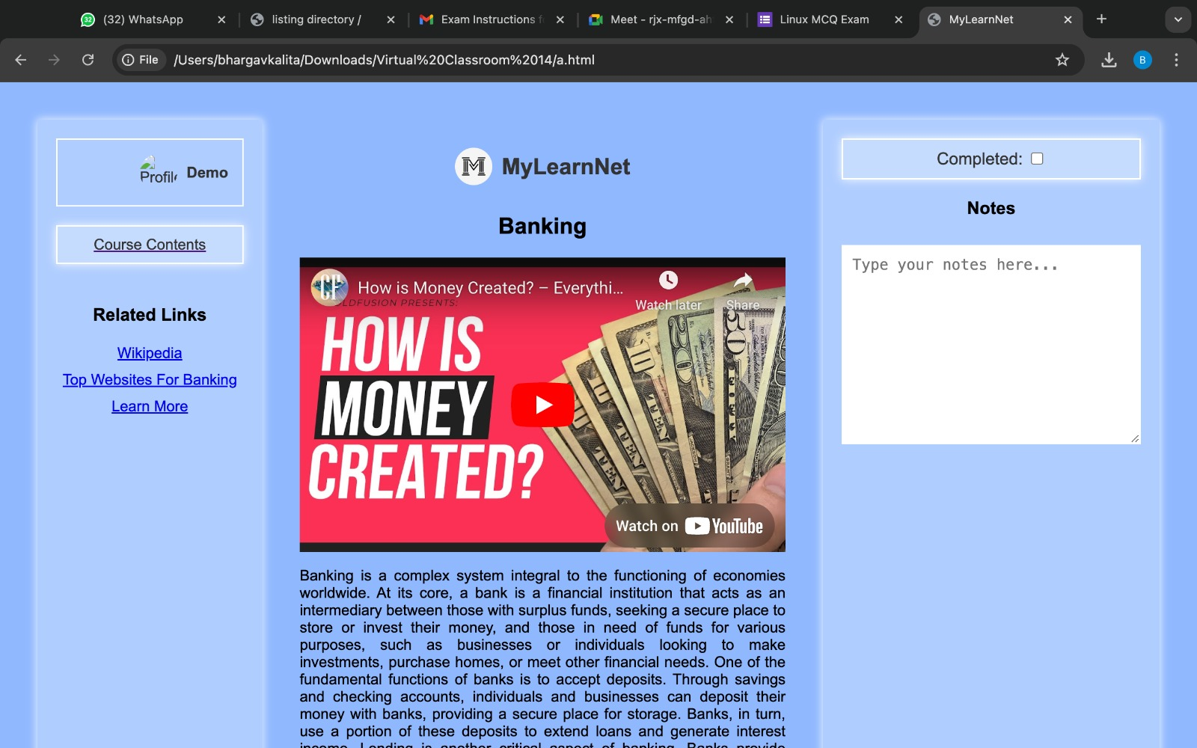

Slide 11
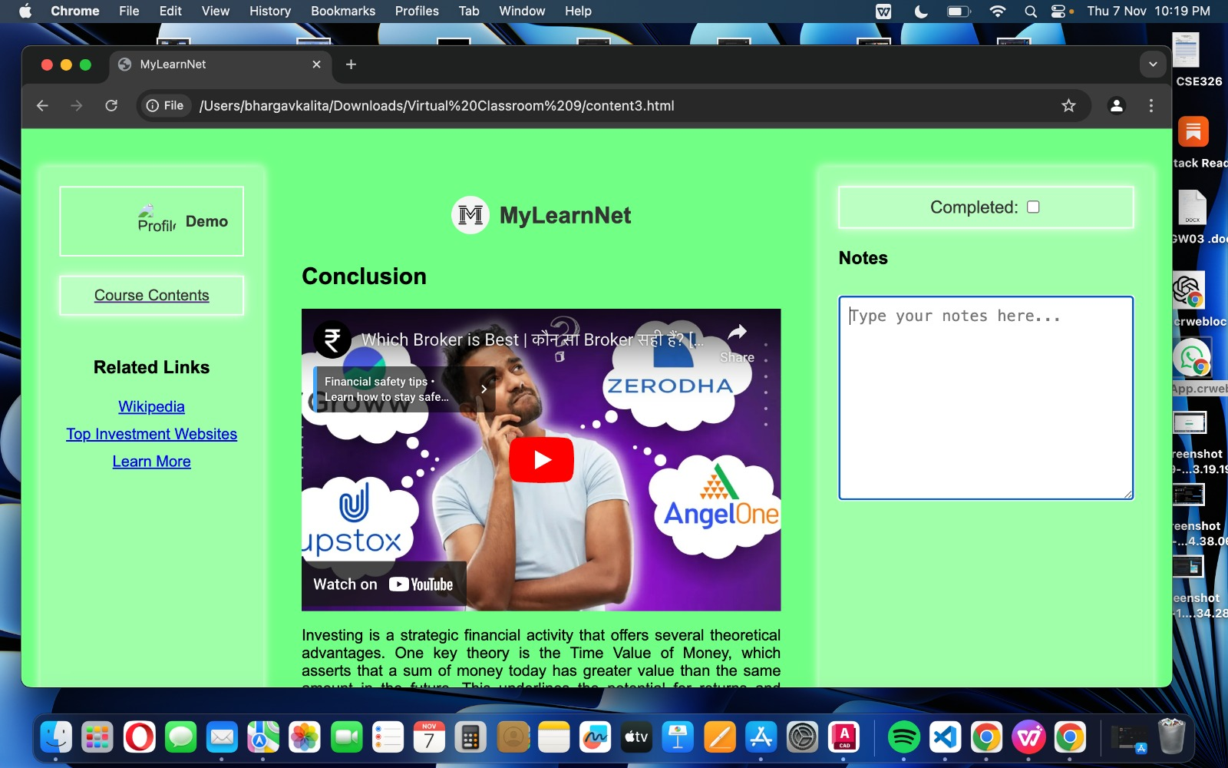

Slide 12
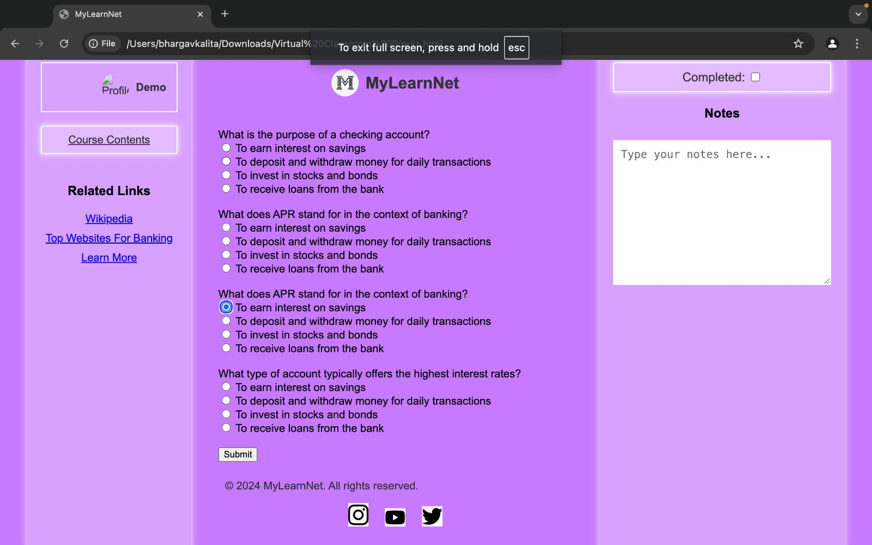

Slide 13
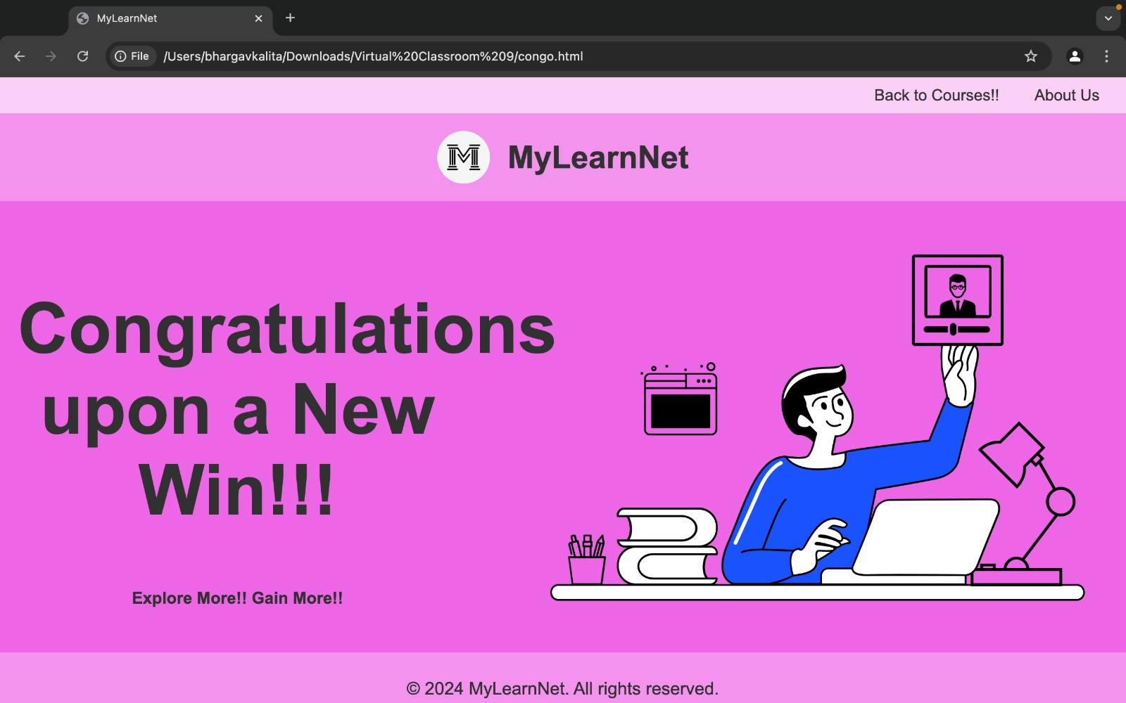

Slide 14
Conclusion:
The website is a virtual classroom for E-learning made with HTML code,CSS,media integration,Responsive Design,HyperLinks and Navigations Testing tools. The main purpose and idea of this website is to help the person in learning online.On signing up or logging in it directs you to the page where u can search whatever content you want to learn and you can learn from it.

Slide 15
References:
https://www.w3schools.com/
https://freecodecamp.com/

